Slide 1
Bitcoin Analysis and Forecasting Using Time Series Models
Group Partners: Rafia
Almas Ayesha Ansari (k201313)

Slide 2
Time Series Models
FB_PROPHET
ARIMA MODEL
SARIMA MODEL
ARCH MODEL

Slide 3
FB PROPHET MODEL
Prophet is a procedure for forecasting time series data based on an additive model where non-linear trends are fit with yearly, weekly, and daily seasonality, plus holiday effects. It works best with time series that have strong seasonal effects and several seasons of historical data. Prophet is robust to missing data and shifts in the trend, and typically handles outliers well.

Slide 4
ARIMA MODEL

Slide 5
SARIMA MODEL
It is an seasonal autoregressive Integrated moving average model.
It is an advanced version of ARIMA.
It is based on Seasonal Trends.
SARIMA Parameters are (P,D,Q)
Where P indicates number of autoregressive terms , Q indicates number of moving average terms and D indicates seasonality.

Slide 6
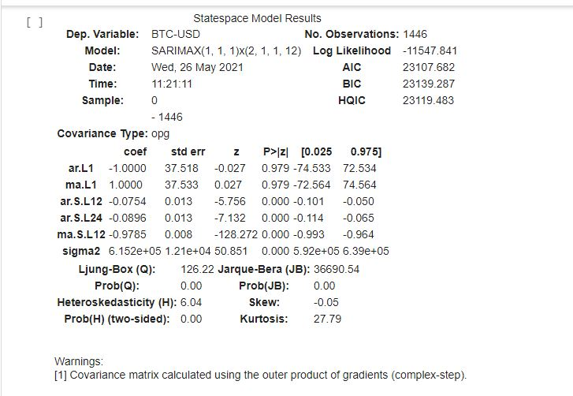
SARIMA MODEL SUMMARY

Slide 7
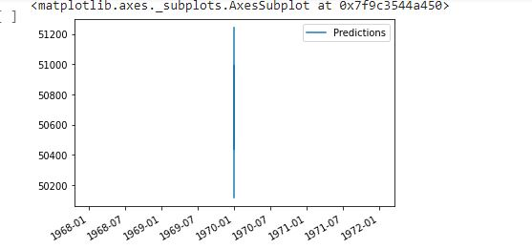
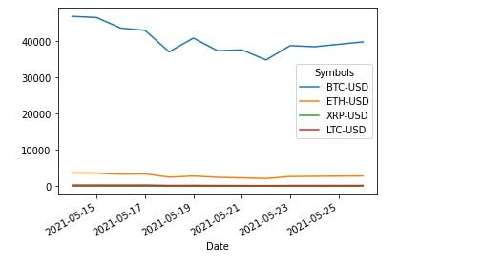
SARIMA MODEL PREDICTIONS

Slide 8
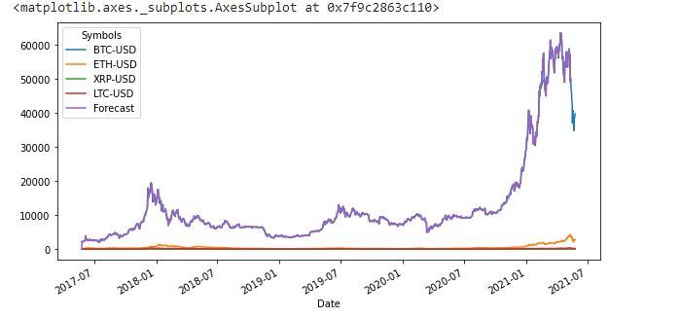
FORECASTING OF SARIMA MODEL

Slide 9
ARCH MODEL
ARCH MODEL is an autoregressive conditionally heteroscedastic model which is used for the variance of a time series.
ARCH MODEL is used to describe changing, possibly volatile variance.
Although ARCH model could be used to describe a gradually increasing variance over time.

Slide 10
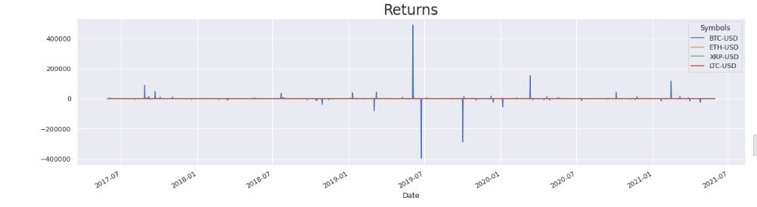
ARCH MODEL RETURNS

Slide 11
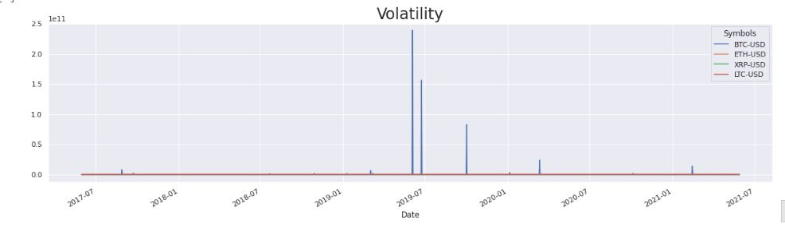
ARCH MODEL VOLATILITY

Slide 12
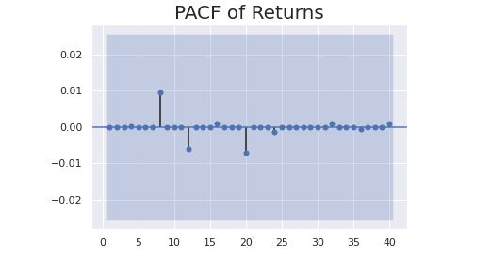
ARCH MODEL PACF OF RETURNS

Slide 13
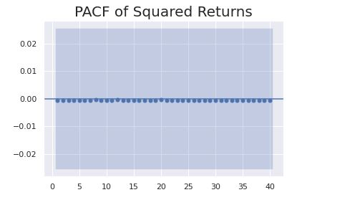
ARCH MODEL PACF OF SQUARED RETURNS

Slide 14
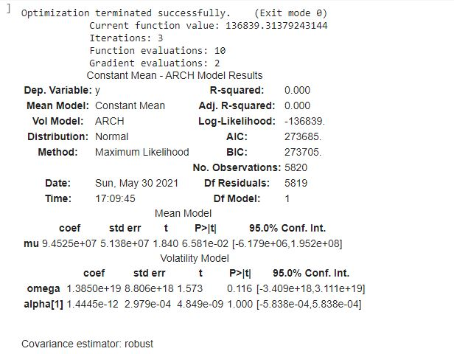
ARCH MODEL SUMMARY

Slide 15
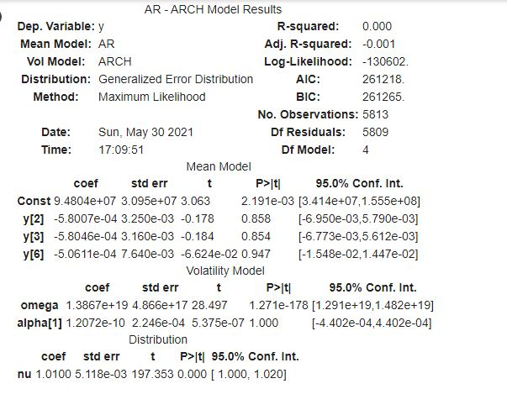
ARCH MODEL RESULTS

Slide 16
GARCH MODEL
GARCH MODEL is an generalized autoregressive conditionally heteroscedastic model.
The goal of GARCH model is to provide volatility measures for hetrocedastic time series data.

Slide 17
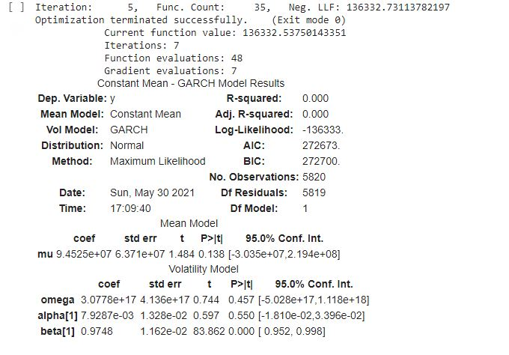
GARCH MODEL SUMMARY

